Slide 1

Performance Highlights and Strategic Review
Year End 2011
Bakers Union & FELRA Health and Welfare Fund
May 4, 2012

Slide 2
Agenda
Observations and Top Drug Reports
Executive Summaries
Catalyst Rx and Industry Updates
Catalyst Rx Web Tools

Slide 3
1. Observations & Top Drug Reports

Slide 4
Observations:
Top Drugs and Disease Classes
Top 25 Drugs used for chronic medical conditions (except PPI drugs)
  High cholesterol (Lipitor, Crestor, Tricor)
  Chronic Inflammatory Disease (Enbrel, Humira)
  Depression/Psychosis (Cymbalta, Provigil, Abilify, Zyprexa,)
  Diabetes (Janumet, Lantus, Actos)
  High Blood Pressure (Diovan HCT, Benicar HCT)
  Asthma (Advair)
Key Generics in 2011 and blockbuster brand names losing patent in 2012:
  Lipitor (December 2011)
  Singulair (August 2012)
  Actos (August 2012)
  Diovan, Diovan/HCT (September 2012)
32% of Top 25 Drugs by Plan Paid are Specialty Medications (8 out of 25)
  Enbrel Sureclick
  Gilenya
  Acthar HP
  Xeloda
  Rebif
  Baraclude
  Hepsera
  Humira

Slide 5
Observations:
Top Drugs and Disease Classes
Top Specialty Disease Classes for 2011
  Rheumatic Diseases
  Endocrine
  Hepatitis B
  Cancer
  Multiple Sclerosis
Increasing trends can be managed with the Formulary Advantage Program
  Targets Non-preferred brand name drugs in both specialty and non-specialty drug classes
  Market changes are monitored and targeted drug classes are changed accordingly
  Current program offerings include non-specialty targeted drug classes: SSRI, PPI, Hypnotics, Androgens, Triptans, Atypical Antipsychotics, Bisphosphonates, Intranasal Steroids, ARBs
  Specialty targeted drug classes include: Follicle Stimulating Hormones, Growth Hormones, Hepatitis C, Multiple Sclerosis, and Interferons, TNF Inhibitors (last two are newest additions)
Generic Dispensing Rate (GDR) reached 64.6% in 4Q2011, averaging at 63.4% for 2011
  An increase of almost 5 percentage points over 2010 (60.9% GDR)

Slide 6
Top 5 Diseases by Plan Cost
 | Disease Category | Total Cost | Patient Paid | Plan Paid | Total Claims | Plan Paid / Claim | PMPM | Utilizers
1 | Cardiovascular Disease | $231,716 | $36,733 | $194,983 | 3,330 | $58.55 | $12.47 | 283
2 | Diabetes | $116,104 | $12,853 | $103,251 | 913 | $113.09 | $6.60 | 81
3 | Rheumatic Diseases/Disorders | $59,645 | $285 | $59,360 | 19 | $3124.22 | $3.80 | 5
4 | Dermatologic Diseases/Disorders | $48,798 | $5,561 | $43,237 | 412 | $104.95 | $2.77 | 168
5 | Miscellaneous Endocrine Diseases | $40,808 | $1,143 | $39,665 | 191 | $207.67 | $2.54 | 99

Slide 7
Top 10 Therapeutic Classes by Plan Cost
 | Therapeutic Classes | Total Cost | Patient Paid | Plain Paid | Total Claims | Plan Paid / Claim | PMPM | Utilizers
1 | ANTIHYPERLIPIDEMICS | $116,168 | $14,320 | $101,848 | 1,086 | $93.78 | $6.51 | 159
2 | ANTIDIABETICS | $99,407 | $8,372 | $91,035 | 681 | $133.68 | $5.82 | 74
3 | ANALGESICS - ANTI-INFLAMMATORY | $68,399 | $2,949 | $65,450 | 410 | $159.63 | $4.19 | 184
4 | ANTIHYPERTENSIVES | $69,387 | $12,258 | $57,129 | 1,109 | $51.51 | $3.65 | 157
5 | PSYCHOTHERAPEUTIC AND NEUROLOGICAL AGENTS - MISC. | $45,150 | $741 | $44,408 | 42 | $1057.34 | $2.84 | 12
6 | ANTIPSYCHOTICS/ANTIMANIC AGENTS | $45,627 | $1,894 | $43,733 | 122 | $358.47 | $2.80 | 14
7 | DERMATOLOGICALS | $48,798 | $5,561 | $43,237 | 412 | $104.95 | $2.77 | 168
8 | ENDOCRINE AND METABOLIC AGENTS - MISC. | $44,367 | $2,440 | $41,927 | 124 | $338.12 | $2.68 | 23
9 | ANTIVIRALS | $39,205 | $1,203 | $38,002 | 102 | $372.57 | $2.43 | 27
10 | ANTIASTHMATIC AND BRONCHODILATOR AGENTS | $41,099 | $4,985 | $36,114 | 296 | $122.01 | $2.31 | 90

Slide 8
Top 20 Drugs by Total Plan Cost
 | Drug Name | Total Cost | Patient Paid | Plain Paid | Total Claims | Plan Paid / Claim | PMPM | Utilizers
1 | LIPITOR | $58,246 | $6,300 | $51,946 | 424 | $122.51 | $3.32 | 64
2 | ENBREL SURECLICK | $39,426 | $165 | $39,261 | 11 | $3569.15 | $2.51 | 2
3 | GILENYA | $30,297 | $120 | $30,177 | 8 | $3772.10 | $1.93 | 1
4 | ACTHAR HP | $27,810 | $30 | $27,780 | 1 | $27780.00 | $1.78 | 1
5 | CRESTOR | $23,663 | $2,505 | $21,158 | 157 | $134.77 | $1.35 | 30
6 | CYMBALTA | $18,901 | $1,260 | $17,641 | 80 | $220.51 | $1.13 | 10
7 | PROVIGIL | $17,414 | $315 | $17,099 | 21 | $814.22 | $1.09 | 2
8 | JANUMET | $15,245 | $1,095 | $14,150 | 68 | $208.09 | $0.90 | 12
9 | ACTOPLUS MET | $14,240 | $795 | $13,445 | 53 | $253.68 | $0.86 | 7
10 | ABILIFY | $13,096 | $360 | $12,736 | 8 | $1591.97 | $0.81 | 2
11 | XELODA | $12,703 | $90 | $12,613 | 6 | $2102.12 | $0.81 | 1
12 | ADVAIR DISKUS | $13,001 | $780 | $12,221 | 47 | $260.02 | $0.78 | 19
13 | LANSOPRAZOLE | $12,951 | $850 | $12,101 | 85 | $142.36 | $0.77 | 10
14 | NEXIUM | $12,922 | $1,035 | $11,887 | 69 | $172.28 | $0.76 | 11
15 | ZYPREXA | $11,538 | $150 | $11,388 | 10 | $1138.79 | $0.73 | 2
16 | REBIF | $11,278 | $60 | $11,218 | 4 | $2804.60 | $0.72 | 1
17 | BARACLUDE | $11,362 | $210 | $11,152 | 14 | $796.60 | $0.71 | 1
18 | SINGULAIR | $12,017 | $1,155 | $10,862 | 66 | $164.58 | $0.69 | 15
19 | LANTUS SOLOSTAR | $11,079 | $885 | $10,194 | 59 | $172.78 | $0.65 | 12
20 | HEPSERA | $10,269 | $165 | $10,104 | 11 | $918.53 | $0.65 | 1

Slide 9
Top Specialty Drugs by Plan Cost
Brand Name | Claims | Plan Cost | Member Copayment | Avg Plan Cost | Avg Member
ENBREL SURECLICK | 11 | $39,260.61 | $165.00 | $3,569.15 | $15.00
HUMIRA PEN | 5 | $9,336.55 | $75.00 | $1,867.31 | $15.00
HUMIRA PEN-CROHNS DISEASESTARTER | 1 | $5,267.47 | $15.00 | $5,267.47 | $15.00
HUMIRA PEN-PSORIASIS STARTER | 1 | $3,749.65 | $15.00 | $3,749.65 | $15.00
HUMIRA | 1 | $1,745.82 | $15.00 | $1,745.82 | $15.00
Rheumatic Diseases/Disorders |  | $59,360.10
GILENYA | 8 | $30,176.77 | $120.00 | $3,772.10 | $15.00
 |  | $30,176.77
ACTHAR HP | 1 | $27,780.00 | $30.00 | $27,780.00 | $30.00
Miscellaneous Endocrine Diseases |  | $27,780.00
BARACLUDE | 14 | $11,152.40 | $210.00 | $796.60 | $15.00
HEPSERA | 11 | $10,103.84 | $165.00 | $918.53 | $15.00
Hepatitis Agents |  | $21,256.24
XELODA | 6 | $12,612.72 | $90.00 | $2,102.12 | $15.00
Cancer |  | $12,612.72
REBIF | 4 | $11,218.38 | $60.00 | $2,804.60 | $15.00
Multiple Sclerosis |  | $11,218.38
SYNVISC ONE | 3 | $2,471.85 | $45.00 | $823.95 | $15.00
SYNVISC | 2 | $1,866.30 | $30.00 | $933.15 | $15.00
Pain Management |  | $4,338.15
ONDANSETRON ODT | 7 | $960.07 | $70.00 | $137.15 | $10.00
ONDANSETRON HCL | 10 | $765.60 | $95.75 | $76.56 | $9.58
Other GI Diseases/Disorders |  | $1,725.67
ENOXAPARIN SODIUM | 2 | $1,214.58 | $20.00 | $607.29 | $10.00
Hematologic Diseases/Disorders |  | $1,214.58
Total Net Claims | 87 | $169,682.61

Slide 10
2. Executive Summaries

Slide 11
2011 Quarterly Executive Summary
 | Q1 2011 | Q2 2011 | Q3 2011 | Q4 2011 | Rolling Total for 4 Quarters
Membership Summary
Member Count | 1,319 | 1,302 | 1,274 | 1,317 | 1,303
Utilizing Member Count | 380 | 387 | 370 | 388 | 381
Percent Utilizing | 28.8% | 29.7% | 29.0% | 29.5% | 29.3%
Claim Summary
Net Claims (Mail/Retail) | 2,798 | 2,890 | 2,683 | 2,808 | 11,179
Claims per Elig Member per Quarter | 2.12 | 2.22 | 2.11 | 2.13 | 2.14
Total Claims for Brand | 985 | 997 | 941 | 914 | 3,837
Total Claims for Generic | 1,754 | 1,834 | 1,688 | 1,813 | 7,089
Total Claims for Brand w/Gen Equiv | 59 | 59 | 54 | 81 | 253
Generic % of Total Claims | 62.7% | 63.5% | 62.9% | 64.6% | 63.4%
Mail Order Claims | 57 | 62 | 58 | 65 | 242
Mail Order % of Total Claims | 2.0% | 2.1% | 2.2% | 2.3% | 2.2%
Claims Cost Summary
Total Prescription Cost | $252,134.92 | $252,763.11 | $238,183.82 | $275,176.78 | $1,018,258.63
Total Ingredient Cost | $248,453.47 | $249,103.01 | $234,785.67 | $271,613.73 | $1,003,955.88
Total Dispensing Fee | $3,681.45 | $3,660.10 | $3,398.15 | $3,563.05 | $14,302.75
Total Other (e.g. tax) | $0.00 | $0.00 | $0.00 | $0.00 | $0.00
Avg Total Cost per Claim | $90.11 | $87.46 | $88.78 | $98.00 | $91.09
Avg Total Cost for Brand | $204.45 | $187.13 | $201.55 | $238.53 | $207.36
Avg Total Cost for Generic | $26.73 | $32.80 | $26.31 | $27.47 | $28.39
Avg Total Cost for Brand w/Gen Equiv | $65.69 | $102.40 | $76.27 | $90.82 | $84.56
Member Cost Summary
Total Copay | $32,588.04 | $34,145.39 | $28,787.01 | $29,385.26 | $124,905.70
Avg Copay per Claim | $11.65 | $11.82 | $10.73 | $10.46 | $11.17
Avg Copay for Brand | $17.50 | $17.71 | $17.91 | $17.88 | $17.75
Avg Copay for Generic | $7.87 | $7.94 | $6.17 | $6.21 | $7.06
Avg Copay for Brand w/Gen Equiv | $26.14 | $32.67 | $27.98 | $21.98 | $26.72
Copay % of Total Prescription Cost | 12.9% | 13.5% | 12.1% | 10.7% | 12.3%
Other Plan Paid Cost Summary
Total Other Plan Paid Cost | $0.00 | $0.00 | $0.00 | $0.00 | $0.00
Plan Cost Summary
Total Plan Cost | $219,546.88 | $218,617.72 | $209,396.81 | $245,791.52 | $893,352.93
Total Specialty Drug Cost | $43,233.87 | $27,699.19 | $31,109.42 | $67,640.13 | $169,682.61
Increase % Total Cost over Last Qtr | 12.0% | -0.4% | -4.2% | 17.4% | 24.7%
Avg Plan Cost per Claim | $78.47 | $75.65 | $78.05 | $87.53 | $79.91
Avg Plan Cost for Brand | $186.95 | $169.42 | $183.64 | $220.65 | $189.61
Avg Plan Cost for Generic | $18.85 | $24.86 | $20.13 | $21.26 | $21.33
Avg Plan Cost for Brand w/Gen Equiv | $39.54 | $69.73 | $48.29 | $68.85 | $57.83
Net PMPM | $55.48 | $55.96 | $54.80 | $62.21 | $57.13
PMPM for Specialty Only | $10.93 | $7.09 | $8.14 | $17.12 | $10.85
PMPM without Specialty | $44.56 | $48.87 | $46.66 | $45.09 | $46.28
Other Summary
Patients 7 or more Claims/Month | 16 | 21 | 17 | 18 | 18
Patients with 3 or more Controls | 5 | 6 | 7 | 6 | 6
Top 5 Drugs
 | ENBREL SURECLICK | LIPITOR | LIPITOR | ACTHAR HP | LIPITOR
 | LIPITOR | GILENYA | GILENYA | LIPITOR | ENBREL SURECLICK
 | REBIF | ENBREL SURECLICK | HUMIRA PEN | GILENYA | GILENYA
 | CRESTOR | CRESTOR | PROVIGIL | XELODA | ACTHAR HP
 | HUMIRA PEN-CROHNS DISEASESTARTER | PROVIGIL | CYMBALTA | ENBREL SURECLICK | CRESTOR

Slide 12
2011 Monthly Executive Summary
 | Jan - 2011 | Feb - 2011 | Mar - 2011 | Apr - 2011 | May - 2011 | Jun - 2011 | Jul - 2011 | Aug - 2011 | Sep - 2011 | Oct - 2011 | Nov - 2011 | Dec - 2011 | Rolling Total for 12 Months
Membership Summary
Member Count | 1,337 | 1,314 | 1,306 | 1,294 | 1,308 | 1,305 | 1,286 | 1,294 | 1,241 | 1,232 | 1,232 | 1,487 | 1,303
Utilizing Member Count | 376 | 380 | 385 | 388 | 390 | 385 | 380 | 369 | 361 | 393 | 385 | 386 | 381
Percent Utilizing | 28.1% | 28.9% | 29.5% | 30.0% | 29.8% | 29.5% | 29.5% | 28.5% | 29.1% | 31.9% | 31.3% | 26.0% | 29.3%
Claim Summary
Net Claims (Mail/Retail) | 930 | 892 | 976 | 952 | 965 | 973 | 924 | 870 | 889 | 908 | 941 | 959 | 11,179
Claims per Elig Member per Month | 0.70 | 0.68 | 0.75 | 0.74 | 0.74 | 0.75 | 0.72 | 0.67 | 0.72 | 0.74 | 0.76 | 0.64 | 0.71
Total Claims for Brand | 322 | 317 | 346 | 339 | 330 | 328 | 330 | 303 | 308 | 303 | 304 | 307 | 3,837
Total Claims for Generic | 590 | 553 | 611 | 594 | 617 | 623 | 577 | 545 | 566 | 588 | 622 | 603 | 7,089
Total Claims for Brand w/Gen Equiv | 18 | 22 | 19 | 19 | 18 | 22 | 17 | 22 | 15 | 17 | 15 | 49 | 253
Generic % of Total Claims | 63.4% | 62.0% | 62.6% | 62.4% | 63.9% | 64.0% | 62.4% | 62.6% | 63.7% | 64.8% | 66.1% | 62.9% | 63.4%
Mail Order Claims | 21 | 21 | 15 | 27 | 9 | 26 | 20 | 19 | 19 | 19 | 28 | 18 | 242
Mail Order % of Total Claims | 2.3% | 2.4% | 1.5% | 2.8% | 0.9% | 2.7% | 2.2% | 2.2% | 2.1% | 2.1% | 3.0% | 1.9% | 2.2%
Claims Cost Summary
Total Prescription Cost | $83,920.32 | $85,278.30 | $82,936.30 | $85,148.18 | $85,245.24 | $82,369.69 | $81,588.93 | $74,849.89 | $81,745.00 | $76,553.30 | $82,623.80 | $115,999.68 | $1,018,258.63
Total Ingredient Cost | $82,699.92 | $84,109.20 | $81,644.35 | $83,950.28 | $84,007.64 | $81,145.09 | $80,418.98 | $73,747.49 | $80,619.20 | $75,405.45 | $81,437.65 | $114,770.63 | $1,003,955.88
Total Dispensing Fee | $1,220.40 | $1,169.10 | $1,291.95 | $1,197.90 | $1,237.60 | $1,224.60 | $1,169.95 | $1,102.40 | $1,125.80 | $1,147.85 | $1,186.15 | $1,229.05 | $14,302.75
Total Other (e.g. tax) | $0.00 | $0.00 | $0.00 | $0.00 | $0.00 | $0.00 | $0.00 | $0.00 | $0.00 | $0.00 | $0.00 | $0.00 | $0.00
Avg Total Cost per Claim | $90.24 | $95.60 | $84.98 | $89.44 | $88.34 | $84.66 | $88.30 | $86.03 | $91.95 | $84.31 | $87.80 | $120.96 | $91.09
Avg Total Cost for Brand | $204.83 | $222.86 | $187.23 | $183.10 | $184.67 | $193.78 | $198.44 | $195.33 | $211.00 | $200.81 | $206.03 | $307.94 | $207.36
Avg Total Cost for Generic | $28.66 | $24.45 | $26.92 | $36.20 | $36.21 | $26.19 | $26.15 | $25.01 | $27.72 | $24.77 | $30.12 | $27.37 | $28.39
Avg Total Cost for Brand w/Gen Equiv | $58.74 | $50.66 | $89.67 | $82.97 | $109.28 | $113.54 | $59.72 | $92.54 | $71.19 | $67.19 | $83.78 | $101.18 | $84.56
Member Cost Summary
Total Copay | $10,735.43 | $10,712.22 | $11,140.39 | $12,059.38 | $11,467.43 | $10,618.58 | $9,653.84 | $9,776.13 | $9,357.04 | $9,645.13 | $9,797.59 | $9,942.54 | $124,905.70
Avg Copay per Claim | $11.54 | $12.01 | $11.41 | $12.67 | $11.88 | $10.91 | $10.45 | $11.24 | $10.53 | $10.62 | $10.41 | $10.37 | $11.17
Avg Copay for Brand | $17.38 | $17.84 | $17.29 | $17.60 | $17.44 | $18.09 | $17.48 | $18.44 | $17.87 | $17.39 | $18.25 | $18.00 | $17.75
Avg Copay for Generic | $8.11 | $7.72 | $7.78 | $9.02 | $8.69 | $6.17 | $6.12 | $6.10 | $6.30 | $6.21 | $6.27 | $6.16 | $7.06
Avg Copay for Brand w/Gen Equiv | $19.60 | $35.68 | $21.30 | $38.72 | $19.56 | $38.17 | $20.88 | $39.39 | $19.29 | $42.73 | $23.36 | $14.35 | $26.72
Copay % of Total Prescription Cost | 12.8% | 12.6% | 13.4% | 14.2% | 13.5% | 12.9% | 11.8% | 13.1% | 11.4% | 12.6% | 11.9% | 8.6% | 12.3%
Other Plan Paid Cost Summary
Total Other Plan Paid Cost | $0.00 | $0.00 | $0.00 | $0.00 | $0.00 | $0.00 | $0.00 | $0.00 | $0.00 | $0.00 | $0.00 | $0.00 | $0.00
Plan Cost Summary
Total Plan Cost | $73,184.89 | $74,566.08 | $71,795.91 | $73,088.80 | $73,777.81 | $71,751.11 | $71,935.09 | $65,073.76 | $72,387.96 | $66,908.17 | $72,826.21 | $106,057.14 | $893,352.93
Total Specialty Drug Cost | $15,250.60 | $16,871.39 | $11,111.88 | $7,685.29 | $10,249.85 | $9,764.05 | $11,277.84 | $7,342.50 | $12,489.08 | $15,681.43 | $8,742.93 | $43,215.77 | $169,682.61
Increase % Total Cost over Last 3 Mos. | 10.7% | 11.4% | 12.0% | 4.4% | 2.1% | -0.4% | -0.9% | -4.5% | -4.2% | -6.0% | 1.6% | 17.4%
Avg Plan Cost per Claim | $78.69 | $83.59 | $73.56 | $76.77 | $76.45 | $73.74 | $77.85 | $74.80 | $81.43 | $73.69 | $77.39 | $110.59 | $79.91
Avg Plan Cost for Brand | $187.45 | $205.01 | $169.94 | $165.50 | $167.22 | $175.69 | $180.97 | $176.89 | $193.13 | $183.42 | $187.78 | $289.94 | $189.61
Avg Plan Cost for Generic | $20.54 | $16.72 | $19.15 | $27.18 | $27.52 | $20.01 | $20.03 | $18.91 | $21.42 | $18.56 | $23.85 | $21.21 | $21.33
Avg Plan Cost for Brand w/Gen Equiv | $39.14 | $14.98 | $68.37 | $44.25 | $89.72 | $75.38 | $38.84 | $53.14 | $51.89 | $24.46 | $60.42 | $86.83 | $57.83
Net PMPM | $54.74 | $56.75 | $54.97 | $56.48 | $56.41 | $54.98 | $55.94 | $50.29 | $58.33 | $54.31 | $59.11 | $71.32 | $57.13
PMPM for Specialty Only | $11.41 | $12.84 | $8.51 | $5.94 | $7.84 | $7.48 | $8.77 | $5.67 | $10.06 | $12.73 | $7.10 | $29.06 | $10.85
PMPM without Specialty | $43.33 | $43.91 | $46.47 | $50.54 | $48.57 | $47.50 | $47.17 | $44.61 | $48.27 | $41.58 | $52.02 | $42.26 | $46.28
Other Summary
Patients 7 or more Claims/Month | 15 | 13 | 19 | 23 | 18 | 21 | 19 | 16 | 17 | 13 | 21 | 20 | 18
Patients with 3 or more Controls | 6 | 4 | 6 | 7 | 5 | 5 | 7 | 8 | 7 | 6 | 6 | 6 | 6
Top 5 Drugs
 | ENBREL SURECLICK | ENBREL SURECLICK | REBIF | LIPITOR | LIPITOR | LIPITOR | LIPITOR | LIPITOR | LIPITOR | LIPITOR | GILENYA | ACTHAR HP | LIPITOR
 | LIPITOR | HUMIRA PEN-CROHNS DISEASESTARTER | LIPITOR | ENBREL SURECLICK | GILENYA | GILENYA | ENBREL SURECLICK | GILENYA | HUMIRA PEN-PSORIASIS STARTER | XELODA | LIPITOR | XELODA | ENBREL SURECLICK
 | REBIF | LIPITOR | ENBREL SURECLICK | JANUMET | ENBREL SURECLICK | ABILIFY | GILENYA | CYMBALTA | GILENYA | GILENYA | PROVIGIL | GILENYA | GILENYA
 | CRESTOR | REBIF | CYMBALTA | ANDROGEL | CRESTOR | CYMBALTA | JANUMET | HUMIRA PEN | ABILIFY | ENBREL SURECLICK | CYMBALTA | ENBREL SURECLICK | ACTHAR HP
 | ADVAIR DISKUS | ABILIFY | CRESTOR | HUMIRA | ZYPREXA | HUMIRA PEN | HUMIRA PEN | PROVIGIL | XELODA | CRESTOR | XELODA | LIPITOR | CRESTOR

Slide 13
3. Catalyst Rx and Industry Updates

Slide 14
Formulary Advantage Class Updates
  2011 Formulary Advantage Classes
  Androgens – Testosterone replacement
  *Angiotensin II Receptor Blockers (ARB’s) – High Blood Pressure
  Atypical Antipsychotics – Mental health conditions
  *Bisphosphonates – Osteoporosis
  Hypnotics – Sleep Aids
  *Intranasal Steroids – Nasal Allergy
  *Proton Pump Inhibitors - Ulcers
  Select Serotonin Reuptake Inhibitors – Depression
  *Triptans – Migraines
  Growth Hormones
  Current Classes
  New* 2012 Formulary Advantage Classes
  Albuterol inhalers¹ - Asthma
  Fenofibrates¹ – High triglycerides/cholesterol
  GLP Inhibitors¹ - Diabetes
  Glucose Test Strips¹ - Diabetes
  Insulin¹ – Diabetes
  Insulin, Basal¹ – Diabetes
  Opthalmic Prostaglandins¹ – Glaucoma, Increased ocular pressure
  Follicle Stimulating Hormones - Infertility¹
  Hepatitis C¹
  Multiple Sclerosis¹
  Interferons
  TNF Inhibitors
¹New Classes Effective 1/1/2012. Program targets highly utilized therapeutic classes.
Notes:
Write up talking point coupons example

Slide 15
Catalyst Rx Formulary Advantage
Classes selected for high number of therapeutically equivalent alternatives
Drive generic utilization and formulary compliance, leading to lowest net cost
Savings accrue to your bottom line
All targets are non-preferred when you implement the Formulary Advantage Program
Drug Class | Targeted Medications | Preferred Alternatives | Expected Generic Dispense Rate | Expected Formulary Compliance
Albuterol Asthma | Proventil HFA, Ventolin HFA, Xopenex HFA | ProAir HFA | ** | >90%
Androgens Testosterone Replacement | Androderm, Axiron, Fortesta, Testim | AndroGel | ** | >90%
Angiotensin II Receptor Blockers Blood Pressure | Atacand/HCT, Avalide, Avapro, Benicar/HCT, Edarbi, Edarbyclor, Teveten/HCT | losartan, losartan/hctz, Diovan/HCT, Micardis/HCT | 40-50% | >95%
Atypical Antipsychotics¹ Mental Health Conditions | Abilify, Fanapt, Invega, Latuda, Saphris | risperidone, olanzapine, quetiapine, ziprasidone | 75% | 80-90%
Bisphosphonates Osteoporosis | Actonel, Actonel with Calcium, Atelvia | alendronate, ibandronate, Fosamax Plus D | 60-70% | 90-95%
Fenofibrates High Triglycerides/Cholesterol | Antara, Fenoglide, Lofibra, Tricor, Triglide, Trilipix | Lipofen, and all generic fenofibric acid products | 70-80% | >90%
GLP Inhibitors Diabetes | Victoza | Byetta, Bydureon | ** | >85%
Glucose Test Strips Diabetes | Ascensia, Freestyle, Precision | Accu-Chek and OneTouch Products | ** | >85%
¹ Current utilizers not required to change agents, new utilizers only. ² Unless noted, approval not required for members under age 18. ³NEW DRUG CLASS EFFECTIVE 1/1/2012 ** no or limited current generics in the class
Unless noted, approval not required for members under age 18 and other exceptions may apply.
Notes:
Classes became available 11/1 soft with 1/1 hard but no response from client

Slide 16
Catalyst Rx Formulary Advantage
Drug Class | Targeted Medications | Preferred Alternatives | Expected Generic Dispense Rate | Expected Formulary Compliance
Hypnotics Sleep Aids | Edluar, Lunesta, Rozerem, Silenor, Zolpimist | All generic hypnotics | 80-90% | 80-90%
Insulin Diabetes | Humulin, Humalog | Novolin, Novolog | ** | >95%
Insulin, Basal Diabetes | Levemir | Lantus | ** | 80-90%
Intranasal Steroids Nasal Allergy | Beconase AQ, Nasacort AQ, Omnaris, Rhinocort Aqua, Tri-Nasal, Qnasl, Vancenase AQ, Veramyst | flunisolide, fluticasone propionate, Nasonex | 55-65% | >95%
Ophthalmic Prostaglandins Glaucoma | Lumigan | latanoprost, Travatan Z | 20-30% | 80-90%
Proton Pump Inhibitors Ulcer | AcipHex, Dexilant, Prevacid, Prevacid SoluTabs, Prilosec packets, Zegerid | omeprazole, pantoprazole, Nexium | 40-50% | >95%
SSRIs ² Depression | Luvox CR, Pexeva | citalopram, fluvoxamine, fluoxetine, paroxetine, sertraline | >90% | 80-90%
Triptans Migraine | Axert, Frova, Sumavel, Treximet, Zomig | naratriptan, sumatriptan, Maxalt, Maxalt-MLT, Relpax | 25-35% | >95%
¹ Current utilizers not required to change agents, new utilizers only. ² Unless noted, approval not required for members under age 18.
** no or limited current generics in the class
Unless noted, approval not required for members under age 18 and other exceptions may apply.
Notes:
Note: the acronym FAP is not a client-facing term and should not be used externally – Please refer to these edits as “Formulary Advantage”, “Formulary Advantage Categories”, and “Formulary Advantage programs or programming” (or even “edits”) in external materials/conversations going forward

Slide 17
Catalyst Rx Formulary Advantage Specialty Categories
Drug Class | Targeted Medications | Preferred Alternatives | Expected Generic Dispense Rate | Expected Formulary Compliance
Interferons ³ | Peg Intron | Pegasys | ** | 70-80%
TNF Inhibitors ³ | Cimzia, Orencia, Simponi | Humira ,Enbrel | ** | >95%
Follicle Stimulating Hormones ^{1,2} Infertility | Gonal F | Follistim AQ | ** | 70-80%
Growth Hormones ^{1,2} | Nutropin, Omnitrope, Saizen, Serostim, Zorbitive,Tev-Tropin | Genotropin, Humatrope, Norditropin | ** | 80-90%
Hepatitis C ^{1,} | Victrelis | Incivek | ** | 70-80%
Multiple Sclerosis ^{1,} | Betaseron | Extavia | ** | 80-90%
¹ Current utilizers not required to change agents, new utilizers only. ² Unless noted, approval not required for members under age 18. ³NEW DRUG CLASS EFFECTIVE 4/1/2012
** no or limited current generics in the class
Unless noted, approval not required for members under age 18 and other exceptions may apply.
Notes:
Note: the acronym FAP is not a client-facing term and should not be used externally – Please refer to these edits as “Formulary Advantage”, “Formulary Advantage Categories”, and “Formulary Advantage programs or programming” (or even “edits”) in external materials/conversations going forward

Slide 18

Catalyst Rx In the News
Catalyst Rx Wins URAC’s Top Award
  2011 Platinum Award for Best Practices in Health Care Consumer Empowerment and Protection
  Recognized for its Generic Advantage Plan, empowering members with vital information on lower cost drug alternatives
  Program combines the Formulary Advantage strategic formulary approach, plan design alignment, multi-faceted (print, face-to-face, online) member and provider communications, customer service team education and promotion of Catalyst Price & SaveSM drug pricing center, now available via smartphone technology
Catalyst Rx Achieves TIPPS (Transparency In Pharmaceutical Purchasing Solutions) Certification
  Catalyst Rx recognized by the HR Policy Association as a transparent PBM
  The TIPPS initiative promotes standards that make it easier for employers, their beneficiaries and dependents to understand the true price of a drug
  TIPPS standards are designed to ensure that pharmacy benefit services are structured to encourage the use of the most clinically appropriate and cost-effective drugs available

Slide 19
What’s New in the Industry?
Potential blockbuster class: Oral Anticoagulants
New agents for stroke prevention in atrial fibrillation and venous thromboembolism
The current standard of care, Warfarin, will likely be replaced by these agents
There are currently two medications approved and according to trial data
A third drug, Eliquis, may be slightly clinically superior to the other agents in this class and may eventually be the market leader
Expected to be a $8 billion market by 2016
Brand Name | Generic Name | Comments
Pradaxa | dabigatran | Current indication in atrial fibrillation; Studies in progress in other indications
Xarelto | rivaroxaban | Current indication in post-knee and post-hip surgery; Other indications pending
Eliquis | apixaban | Expected launch 2Q 2012, indicated initially in atrial fibrillation
Catalyst Rx Actions:
  Catalyst Rx has developed a Utilization Management Program to clinically review all new to therapy patients for clients utilizing the Catalyst Rx National Formulary
  Both Pradaxa and Xarelto have programs that developed to manage to their respective indications and mitigate off-label utilization
  Eliquis will have a Utilization Management Program designed to promote appropriate utilization, once approved and accepted to Catalyst Rx’s National Formulary
    .

Slide 20
What’s New in the Industry?
  FDA Guidance on Biosimilars:
    “Biosimilars,” or follow-on biologics, are officially approved subsequent versions of biopharmaceutical products, made by a different manufacturer after a patent has expired for biotech drug (often labeled a specialty medication)
    To improve access, Congress passed the Biologics Price Competition and Innovations (BPCI) Act of 2009, which gave the FDA authorization to oversee an abbreviated pathway for approval of biologics
    The FDA has completed its work on the guidance for approval of biosimilars and plans to release the guidelines by the end of 2011
    Pathway for approval is likely to include:
      A more extensive product review,
      Standards for consideration
      Stricter oversight of manufacturing processes
      Product-specific post-approval safety monitoring
Notes:
A more extensive product review, and a risk-based assessment of interchangeability
Standards for consideration of the product’s complexity, formulation, stability, and functional characteristics
Stricter oversight of manufacturing processes, in order to minimize the potential for variants or impurities
Product-specific post-approval safety monitoring
An overall higher standard of similarity to a reference product
Standards to ensure that products that are not deemed interchangeable are not inadvertently substituted without the prescriber’s consent

Slide 21
What’s New in the Industry?
    According to IMS data Americans spent $307 billion on prescription drugs in 2010. Out of the top fifteen drugs that we spend the most on, 5 are scheduled to go generic by September 2012.
Brand Name | Generic Name | Therapeutic Use | Anticipated Patent Expiration* | % Spend of Top 15 Brands - Catalyst Rx Book of Business
Lexapro¹ | Escitalopram | Antidepressant | March 2012 | 4.98%
Seroquel¹ | Quetiapine | Antipsychotic | March 2012 | 4.37%
Plavix | Clopidogrel | Blood thinner | May 2012 | 11.79%
Singulair | Montelukast | Asthma. seasonal and perennial allergies | August 2012 | 7.76%
Actos | Pioglitazone | Type 2 diabetes | August 2012 | 6.79%
Diovan/Diovan HCT¹ | Valsartan/Valsartan Hydrochlorothiazide | Antihypertensive | September 2012 | 7.16%
Catalyst Rx Actions:
  Catalyst Rx continually works to develop management strategies to mitigate trend within the classes that these new generics will impact proactively
  These products are either currently addressed within our Formulary Advantage Strategy¹ or strategies in development, and to be presented
*Projected launch dates are subject to change as a result from ongoing clinical trials, FDA approval, timing of approvals, manufacturer’s decisions, and any possible litigation. Information is gathered from multiples sources including the FDA CDER, Pharmacist's Letter, and Drugs.com.
**Claim information is from 10/01/2010 – 9/30/2011
Notes:
Big Changes – strategy coming by

Slide 22
What’s New in the Industry?
Patient Protection and Affordable Care Act Contraceptive Coverage
The Patient Protection and Affordable Care Act—the health insurance reform legislation—was passed by Congress and signed into law by President Obama on March 23, 2010
The Act requires health plans to cover preventive services, including all FDA-approved contraceptive methods and counseling. A new proposed rule clarifies the required covered services and is open for comment until June 19, 2012.¹
Non-grandfathered plans and issuers are required to provide coverage without cost sharing consistent with these guidelines in the first plan year (in the individual market, policy year) that begins on or after August 1, 2012
Group health plans sponsored by certain religious employers, and group health insurance coverage in connection with such plans, are exempt from the requirement to cover contraceptive services.²
Catalyst Rx Actions:.
The Formulary Operations and Clinical Analytics teams are developing a baseline analysis that will show client impact of covering agents at zero dollar
  The analysis will assume coverage of all agents and a 10% increase in utilization due to the zero dollar coverage
Client’s may request the analysis through their account management team
¹ http://www.gpo.gov/fdsys/pkg/FR-2012-03-21/pdf/2012-6689.pdf
² http://www.regulations.gov/#!documentDetail;D=HHS_FRDOC_0001-0443

Slide 23
4. Catalyst Rx Web Tools

Slide 24
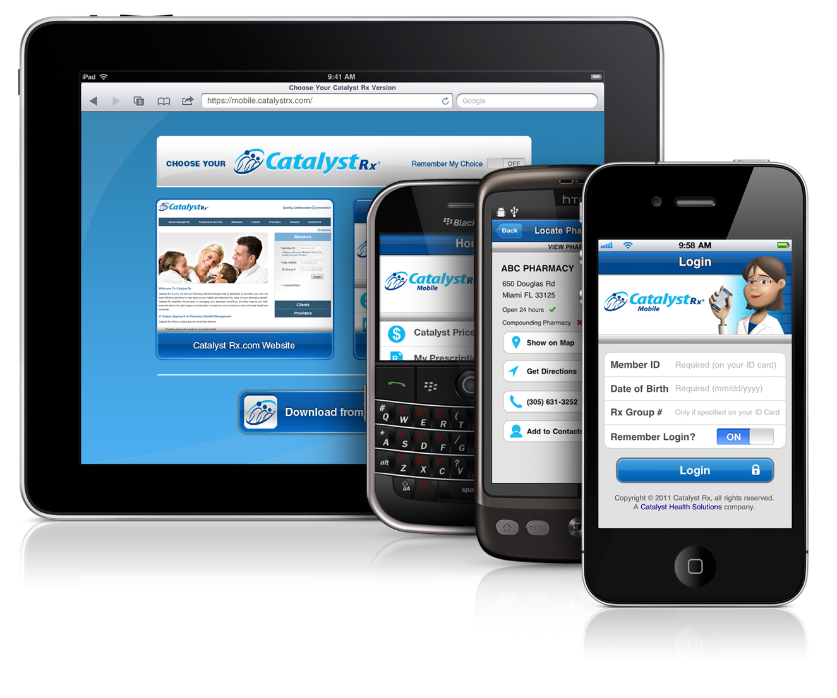



New Mobile Technology:
Engaging Members
Implement Catalyst Rx MobileSM to:
Make smart decisions easier and faster
Increase convenience
Put member history in their hands
Support adherence
Promote generics and formulary compliance
Improve communication with all stakeholders (member, prescriber, pharmacists)
Now available via mobile at catalystrx.com or download the app by going to the Apple App Store, Android Market or Blackberry App World
Notes:
Talk to Price and Save

Slide 25

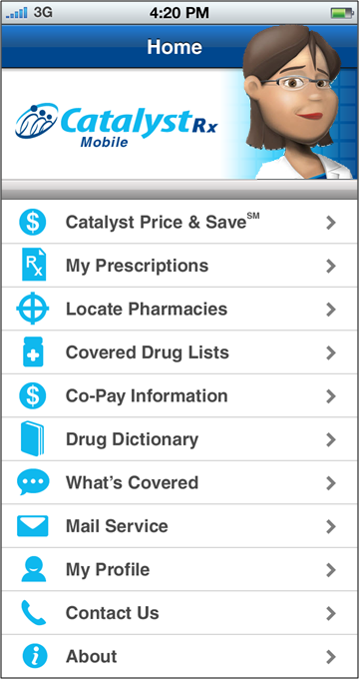
Catalyst Rx MobileSM Features
My Prescriptions
  View prescription history
Formulary Look Up
  Easy access to formulary any time (doctor’s office, pharmacy, home, work)
Co-Pay Information
  Cost benefits of generic versus preferred/ non-preferred brand
Catalyst Price & SaveSM
  Brand vs. generic equivalent pricing
  Search for lowest cost pharmacy
  Review lower cost therapeutic alternative medication options
Locate pharmacies, refill reminders targeted messaging and much more!

Slide 26
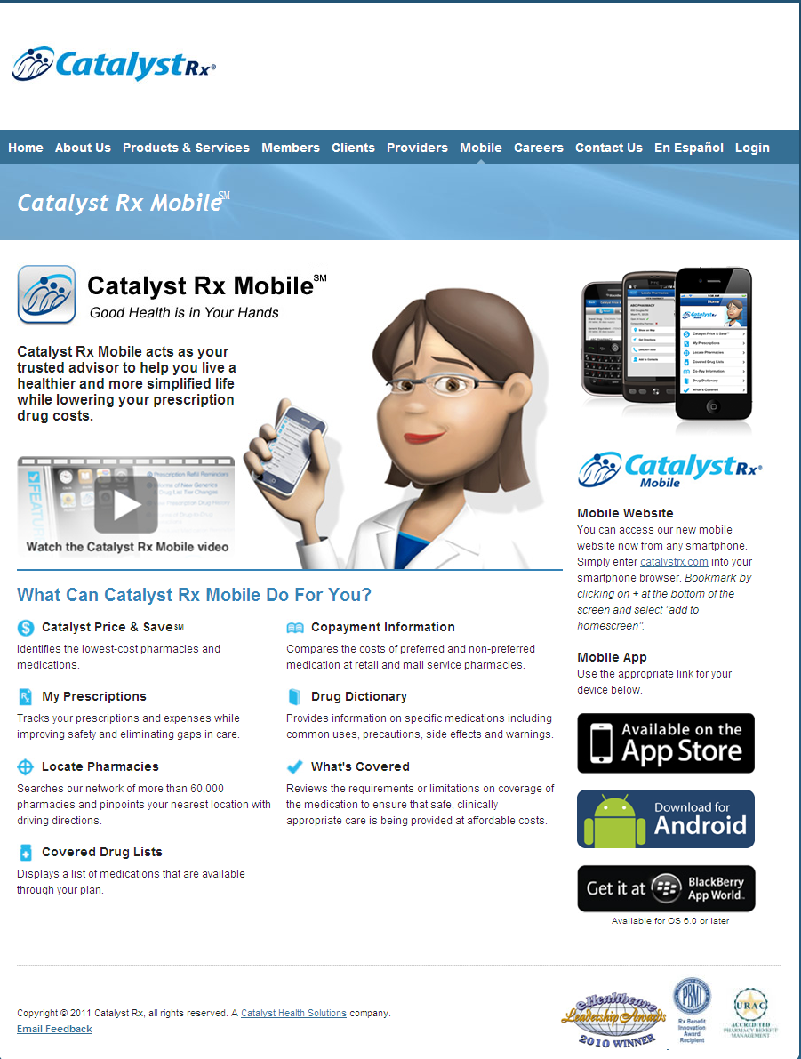
Catalyst Rx MobileSM Promotional Resources
Member flyer in PDF
Webpage on catalystrx.com

